Slide 1

Recursion and Recurrence Relation
Presented by:
Elizer Ponio Jr.
Department of Computer Science
College of Computing and Information Technologies

Slide 2
Outline
Divide and Conquer Approach
Recursion
Recurrence Relation

Slide 3
Divide and Conquer Approach
Divide
Conquer
Combine
Divide the given problem into sub-problems using recursion.
Solve the smaller sub-problems recursively. If the subproblem is small enough, then solve it directly.
Combine the solutions of the sub-problems that are part of the recursive process to solve the actual problem.

Slide 4

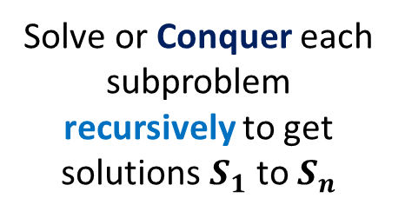

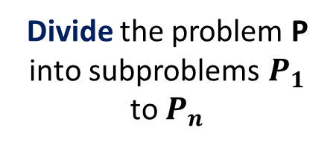







Divide and Conquer Approach
Given problem P
P
Divide the problem P into subproblems $P_{1}$ to $P_{n}$
$$P_{1}$$
$$P_{2}$$
$$P_{3}$$
…
$$P_{n}$$
Solve or Conquer each subproblem recursively to get solutions $S_{1}$ to $S_{n}$
…
$$S_{1}$$
$$S_{2}$$
$$S_{3}$$
$$S_{n}$$
S
Combine solutions $S_{1}$ to $S_{n}$

Slide 5
Divide and Conquer Approach
Divide
Conquer
Combine
Divide the given problem into sub-problems using recursion.
Solve the smaller sub-problems recursively. If the subproblem is small enough, then solve it directly.
Combine the solutions of the sub-problems that are part of the recursive process to solve the actual problem.
In the divide and conquer approach, recursion is used.

Slide 6
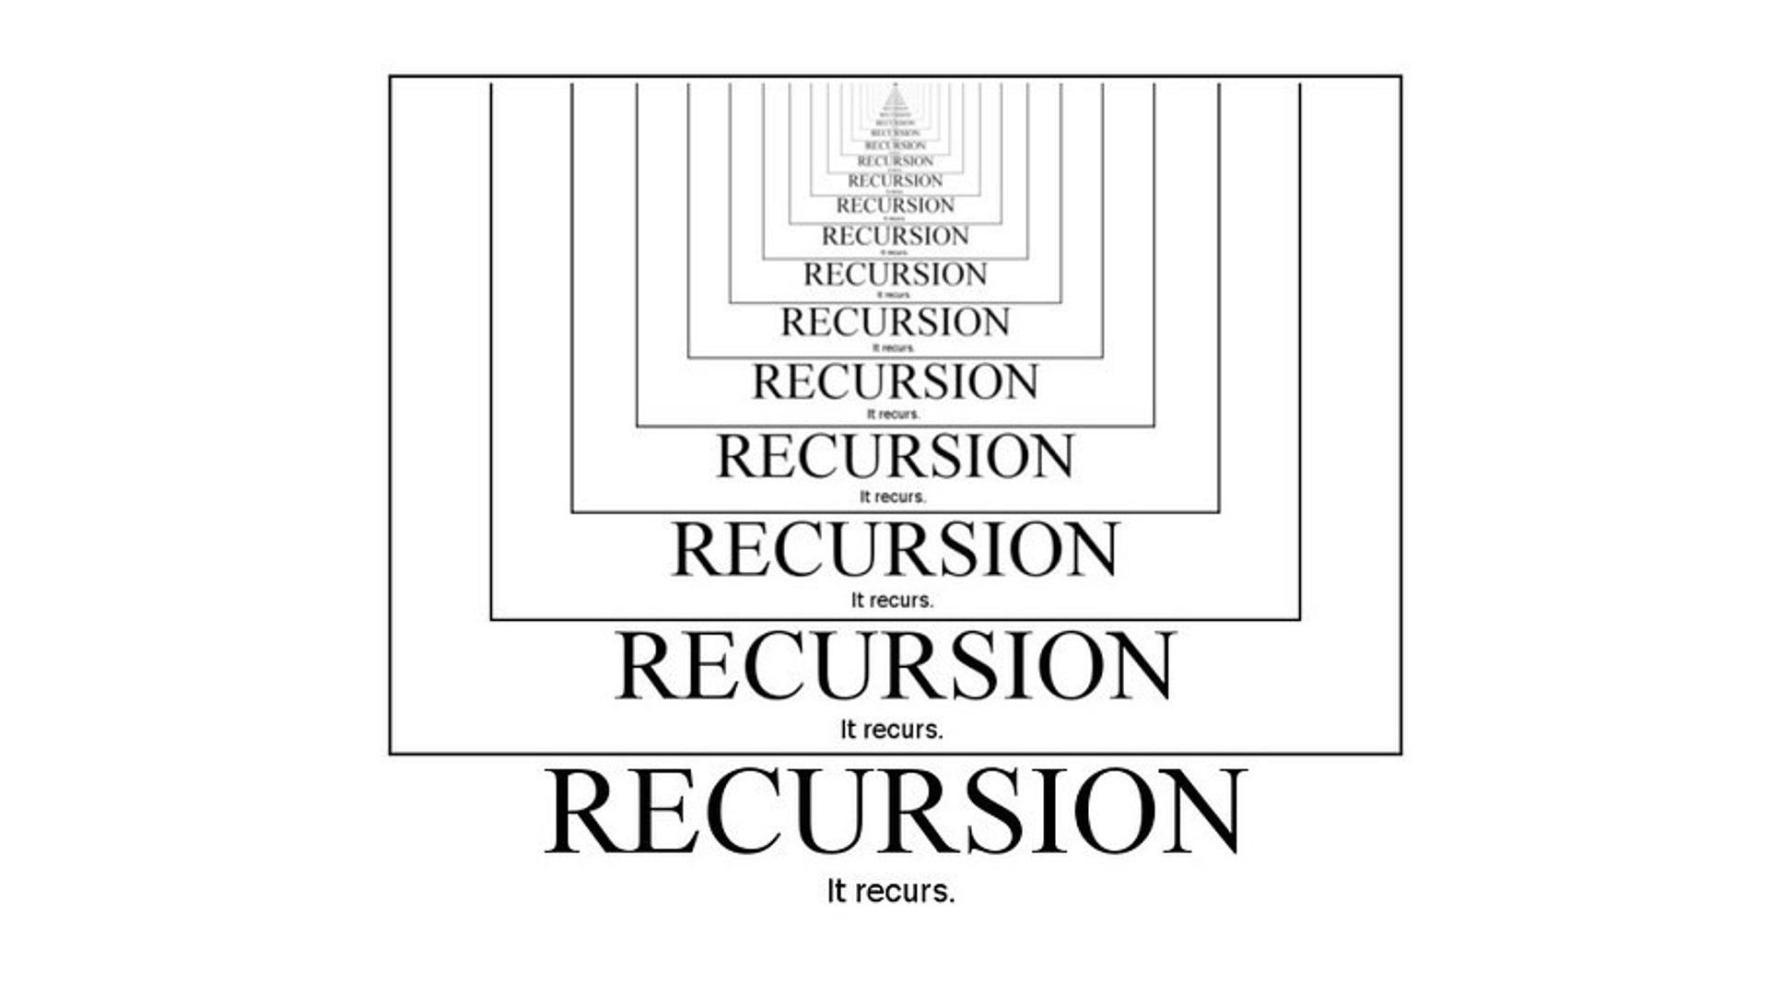
Recursion
In programming, a method that calls itself is known as a recursive method. And, this process is known as recursion.

Slide 7
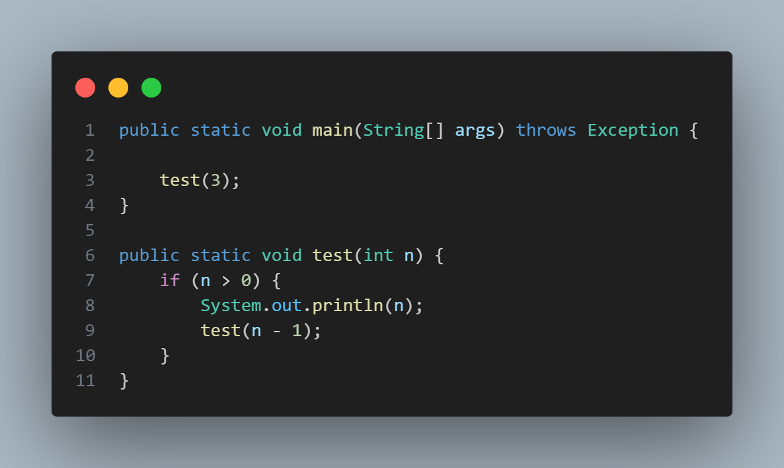
Normal method call
Recursive call

Slide 8

test(3)
3
$$\text{t}\text{est}\text{(}\text{2}\text{)}$$
2
test(1)
1
test(0)

Slide 9
Recurrence Relation
A recurrence relation is a mathematical expression that defines a sequence in terms of its previous terms.
In the context of algorithmic analysis, it is often used to model the time complexity of recursive algorithms.
Recurrence relations describe the running times of recursive algorithms.
Denoted as $T(n)$

Slide 10
Three ways of solving recurrences
1. Substitution method
We make a guess for the solution and then we use mathematical induction to prove the guess is correct or incorrect.
2. Recursion-tree method
We draw a recurrence tree and calculate the time taken by every level of the tree. Finally, we sum the work done at all levels. To draw the recurrence tree, we start from the given recurrence and keep drawing till we find a pattern among levels

Slide 11
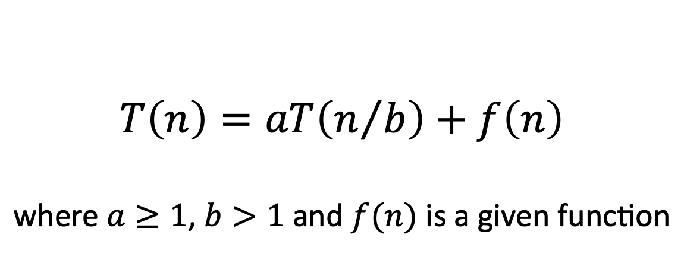
Three ways of solving recurrences
3. The master method
Provides bounds for recurrences of the form,
$$T\left(n\right)=aT\left(n/b\right)+f\left(n\right)$$
$$\text{where} a≥1\text{, }b>1 \text{and} f(n) \text{is} \text{a} \text{given} \text{function}$$

Slide 12



Recurrence Relation Example 1
$$1$$
$$T(n−1)$$
$$T\left(n\right)=T\left(n−1\right)+1$$

Slide 13
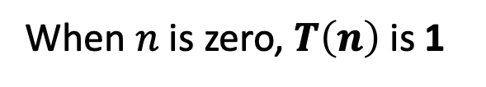
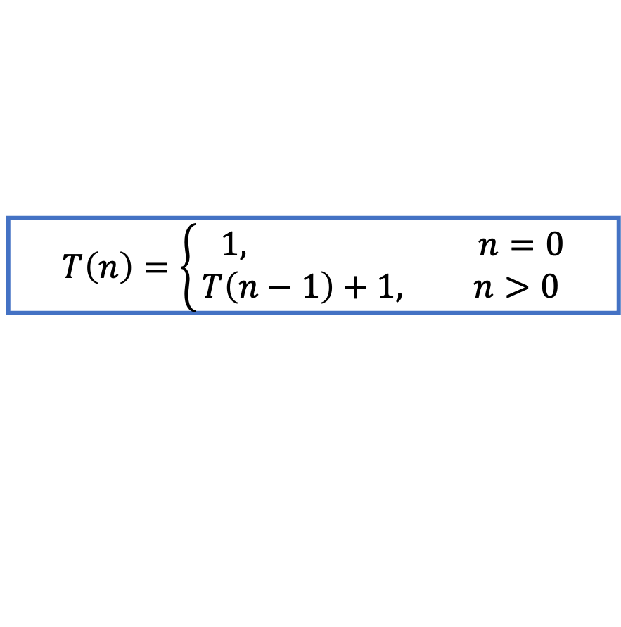
$$T\left(n\right)=\left\{\begin{aligned} 1, n=0 \\ &T\left(n−1\right)+1, n>0\end{aligned}\right.$$
When $n$ is zero, $T\left(n\right)$ is 1
When $n$ is greater than zero, $T\left(n\right) is T\left(n−1\right)+1$

Slide 14
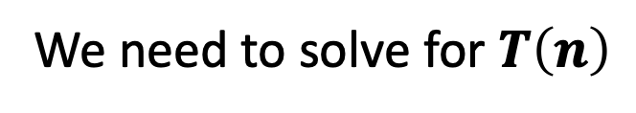
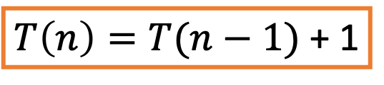
We need to solve for $T\left(n\right)$
$T\left(n\right)=T(n−1)$ + 1

Slide 15
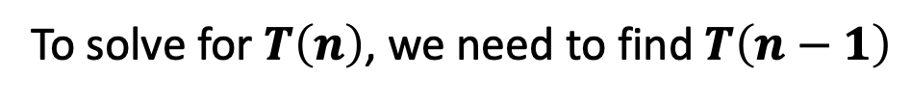
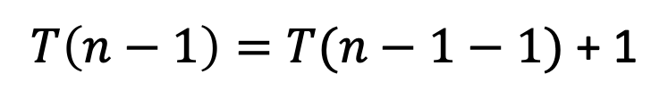


Substitution Method
$T\left(n\right)=T(n−1)$ + 1
To solve for $T\left(n\right)$, we need to find $T\left(n−1\right)$
$T\left(n−1\right)=T(n−1−1)$ + 1
$T\left(n−1\right)=T(n−2)$ + 1

Slide 16











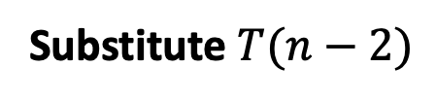

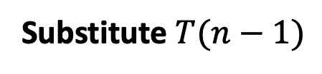
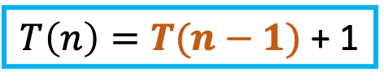


Substitution Method
Substitute $T(n−1)$
$T\left(n\right)=T\left(n−1\right)+1$
$T\left(n\right)=T(n−1)$ + 1
$T\left(n−1\right)=T\left(n−2\right)+1$
$$T\left(n\right)=\left[ T\left(n−2\right)+1\right]+1$$
$$T\left(n\right)= T\left(n−2\right)+2$$
$$T\left(n−2\right)=T\left(n−3\right)+1$$
Substitute $T(n−2)$
$$T\left(n\right)=[T\left(n−3\right)+1]+2$$
$$T\left(n\right)=T\left(n−3\right)+3$$
If we continue till k$…$
$$T\left(n\right)=T\left(n−k\right)+k$$

Slide 17


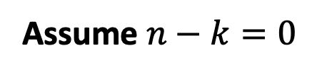

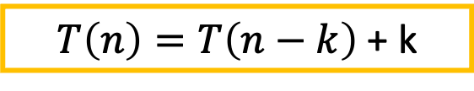
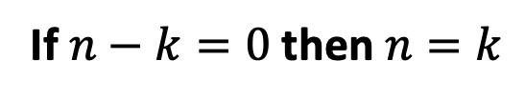

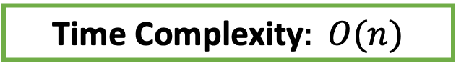
Recurrence Relation
$$T\left(n\right)=\left\{\begin{aligned} 1, n=0 \\ &T\left(n−1\right)+1, n>0\end{aligned}\right.$$
$T\left(n\right)=T\left(n−k\right)$ + k
Assume $n−k=0$
If $n−k=0$then $n=k$
$$T\left(n\right)=T\left(n−n\right)+n$$
$$T\left(n\right)=T\left(0\right)+n$$
$$T\left(n\right)=1+n$$
Time Complexity$: O(n)$

Slide 18
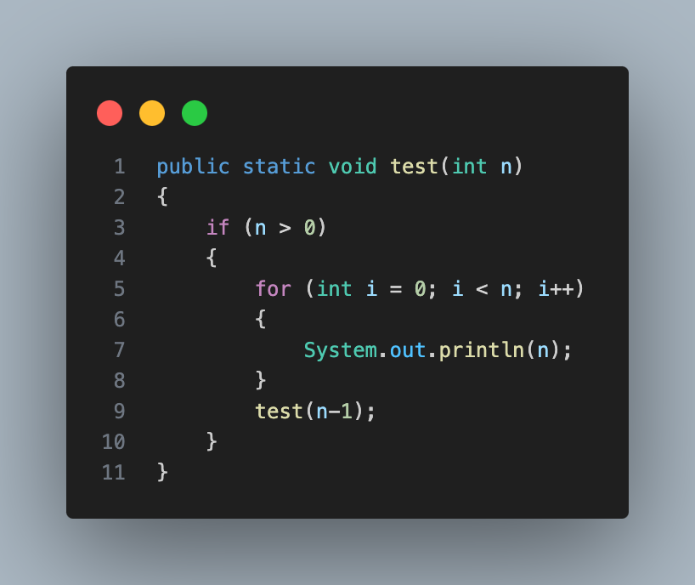







Recurrence Relation Example 2
$$1$$
$$n+1$$
$$n$$
$$T(n−1)$$
$$T\left(n\right)=T\left(n−1\right)+2n+2$$
Convert $2n+2 to n to simplify as,$
$$T\left(n\right)=T\left(n−1\right)+n$$

Slide 19
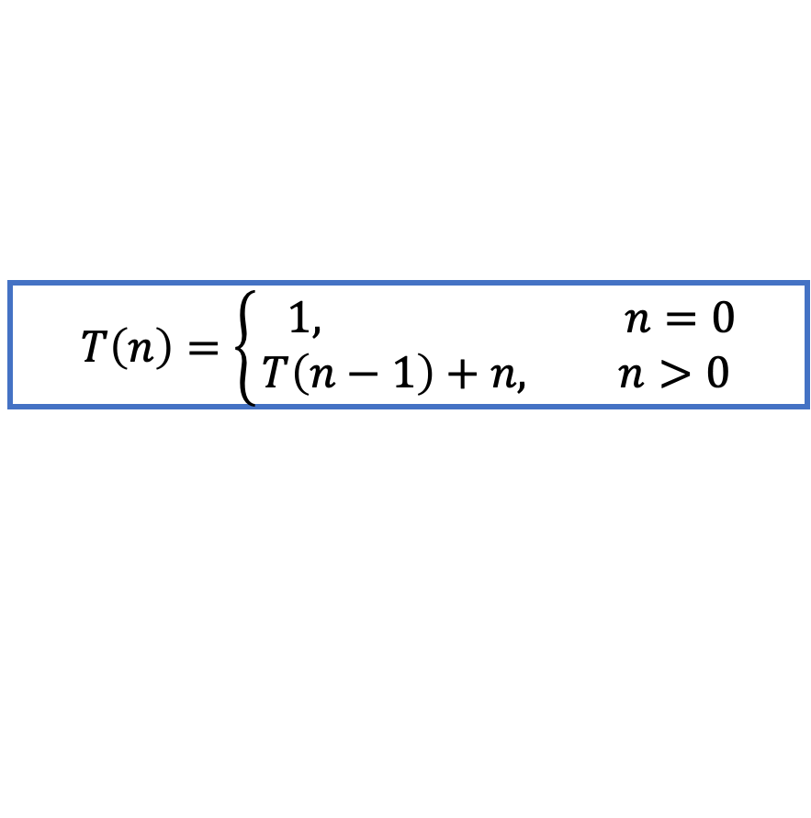
$$T\left(n\right)=\left\{\begin{aligned} 1, n=0 \\ &T\left(n−1\right)+n, n>0\end{aligned}\right.$$

Slide 20













$$T(n)$$
$$n$$
$$T(n−1)$$
$$n−1$$
$$T(n−2)$$
$$n−2$$
$$T(n−3)$$
$$.$$
.
.
$$T(2)$$
$$2$$
$$T(1)$$
$$1$$
$$T(0)$$
X

Slide 21















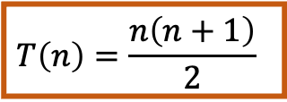








$$T(n)$$
$$n$$
$$n$$
$$T(n−1)$$
$$n−1$$
$$n−1$$
$$T(n−2)$$
$$n−2$$
$$n−2$$
$$T(n−3)$$
$$n−3$$
$$.$$
.
.
$$0+1+2+…+ n−3+n−2+n−1+n=\frac{n\left(n+1\right)}{2}$$
$$T(2)$$
$$2$$
$$2$$
$$T(1)$$
$$1$$
$$1$$
$$T(0)$$
$$0$$
X
$$T\left(n\right)=\frac{n\left(n+1\right)}{2}$$
Time Complexity$: O(n^{2})$

Slide 22

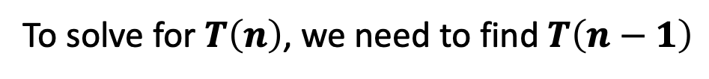



Substitution Method
$$T\left(n\right)=\left\{\begin{aligned} 1, n=0 \\ &T\left(n−1\right)+n, n>0\end{aligned}\right.$$
$T\left(n\right)=T(n−1)$ + n
To solve for $T\left(n\right)$, we need to find $T\left(n−1\right)$
$T\left(n−1\right)=T\left(n−1−1\right)+n−1$
$$T\left(n−1\right)=T\left(n−2\right)+n−1$$

Slide 23










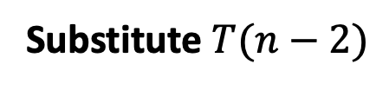

Substitution Method
Substitute $T(n−1)$
$T\left(n\right)=T\left(n−1\right)+n$
$T\left(n\right)=T\left(n−1\right)+n$
$T\left(n−1\right)=T\left(n−2\right)+n −1$
$$T\left(n\right)=\left[ T\left(n−2\right)+n−1\right]+n$$
$T\left(n−2\right)=T\left(n−3\right)+n −2$
$$T\left(n\right)=T\left(n−2\right)+(n−1)+n$$
Substitute $T(n−2)$
$$T\left(n\right)=[T\left(n−3\right)+n−2]+(n−1)+n$$
$$T\left(n\right)=T\left(n−3\right)+(n−2)+(n−1)+n$$
If we continue till k$...$
$$T\left(n\right)=T\left(n−k\right)+(n−(k−1))+(n−(k−2))+n$$

Slide 24
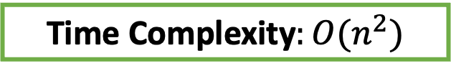

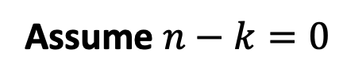
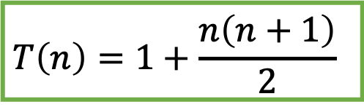

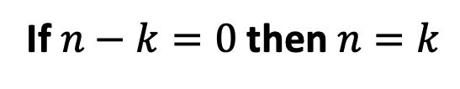
Recurrence Relation
$$T\left(n\right)=\left\{\begin{aligned} 1, n=0 \\ &T\left(n−1\right)+n, n>0\end{aligned}\right.$$
$$T\left(n\right)=T\left(n−k\right)+(n−(k−1))+(n−(k−2))+n$$
Assume $n−k=0$
If $n−k=0$then $n=k$
$$T\left(n\right)=T\left(n−n\right)+\left(n−n+1\right)+\left(n−n+2\right)+\left(n−n+3\right)+n$$
$$T\left(n\right)=T\left(0\right)+1+2+3+ n$$
$$T\left(n\right)=1+\frac{n\left(n+1\right)}{2}$$
Time Complexity$:O(n^{2})$

Slide 25
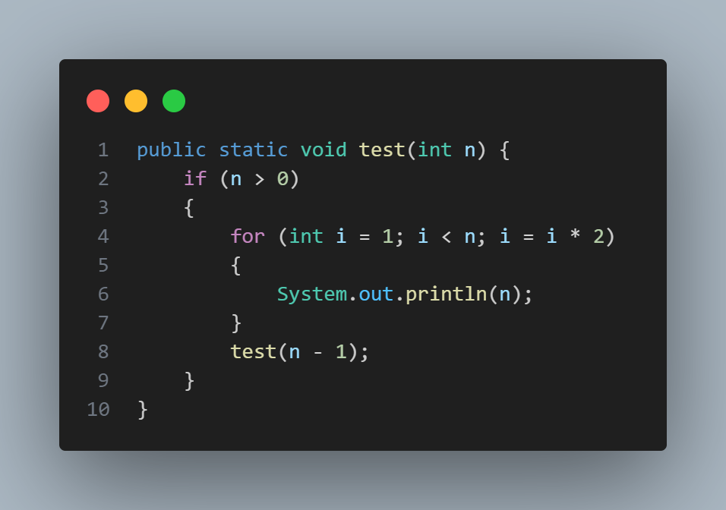



Recurrence Relation Example 3
$$logn$$
$$T(n−1)$$
$$T\left(n\right)=T\left(n−1\right)+logn$$

Slide 26




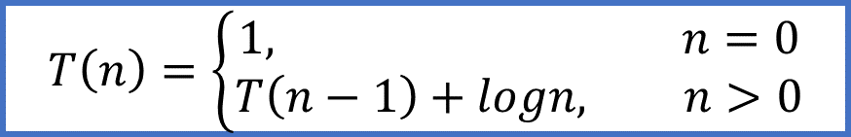
Substitution Method
$$T\left(n\right)=\left\{\begin{aligned}1, n=0 \\ &T\left(n−1\right)+logn, n>0\end{aligned}\right.$$
$T\left(n\right)=T\left(n−1\right)+logn$
$$T\left(n\right)=\left[ T\left(n−2\right)+log⁡(n−1)\right]+logn$$
$T\left(n\right)=T\left(n−2\right)+\log\left(n−1\right)+logn$
$$T\left(n\right)=\left[ T\left(n−3\right)+log⁡(n−2)\right]+\log\left(n−1\right)+logn$$
$T\left(n\right)=T\left(n−3\right)+\log\left(n−2\right)+\log\left(n−1\right)+logn$
If we continue till k$...$

Slide 27
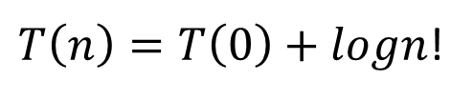
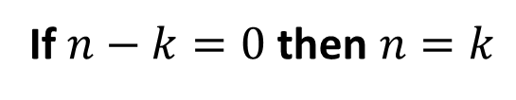
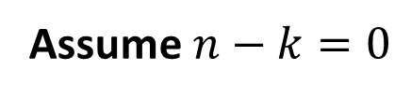
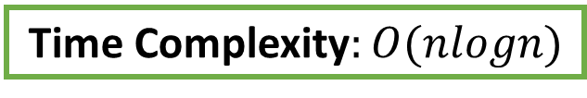
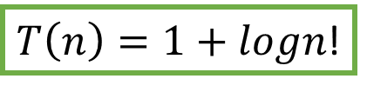
Substitution Method
$$T\left(n\right)=\left\{\begin{aligned}1, n=0 \\ &T\left(n−1\right)+logn, n>0\end{aligned}\right.$$
$$T\left(n\right)=T\left(n−k\right)+log1+log2+…+\log\left(n−1\right)+logn$$
Assume $n−k=0$
If $n−k=0$then $n=k$
$T\left(n\right)=T\left(0\right)+logn$!
$T\left(n\right)=1+logn$!
Time Complexity$:O(nlogn)$

Slide 28
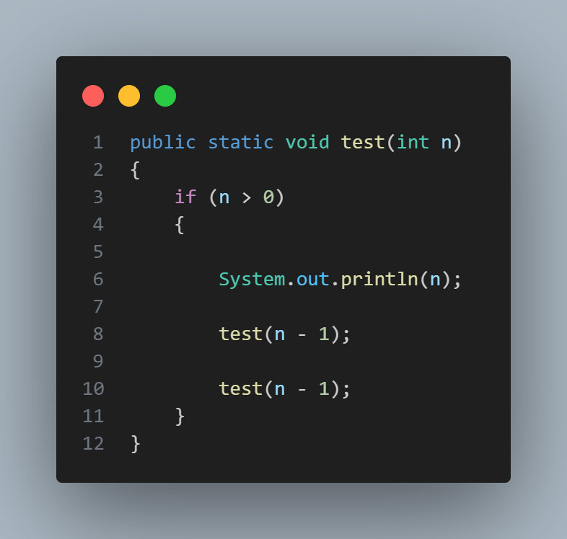




Recurrence Relation Example 4
$$1$$
$$T(n−1)$$
$$T(n−1)$$
$$T\left(n\right)=2T\left(n−1\right)+1$$

Slide 29



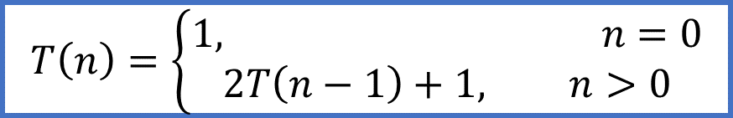

Substitution Method
$$T\left(n\right)=\left\{\begin{aligned}1, n=0 \\ &2T\left(n−1\right)+1, n>0\end{aligned}\right.$$
$T\left(n\right)=2T\left(n−1\right)+1$
$$T\left(n\right)=2\left[ 2T\left(n−2\right)+1\right]+1$$
$T\left(n\right)=2^{2}T\left(n−2\right)+2+1$
$$T\left(n\right)=2^{2}\left[ 2T\left(n−3\right)+1\right]+2+1$$
$$T\left(n\right)=2^{3}T\left(n−3\right)+2^{2}+2+1$$
If we continue till k$...$

Slide 30

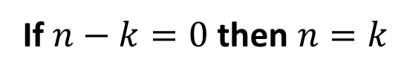


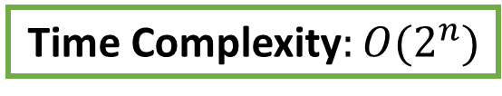

Substitution Method
$$T\left(n\right)=\left\{\begin{aligned}1, n=0 \\ &T\left(n−1\right)+logn, n>0\end{aligned}\right.$$
$T\left(n\right)=2^{k}T\left(n−k\right)+2^{k−1}+2^{k−2}+…+$ $2^{2}+2+1$
Assume $n−k=0$
If $n−k=0$then $n=k$
$T\left(n\right)=2^{n}T\left(n−n\right)+2^{n−1}+2^{n−2}+…+$ $2^{2}+2+1$
$T\left(n\right)=2^{n}T\left(0\right)+1+2+$ $2^{2}+…+2^{k−1}$
$$T\left(n\right)=2^{n}T\left(0\right)+2^{k}−1$$
$$T\left(n\right)=2^{n}+2^{n}−1$$
$$T\left(n\right)=2^{n+1}−1$$
Time Complexity$:O(2^{n})$

Slide 31
References
https://www.programiz.com/dsa/divide-and-conquer
https://www.geeksforgeeks.org/recurrence-relations-a-complete-guide/

